Slide 1
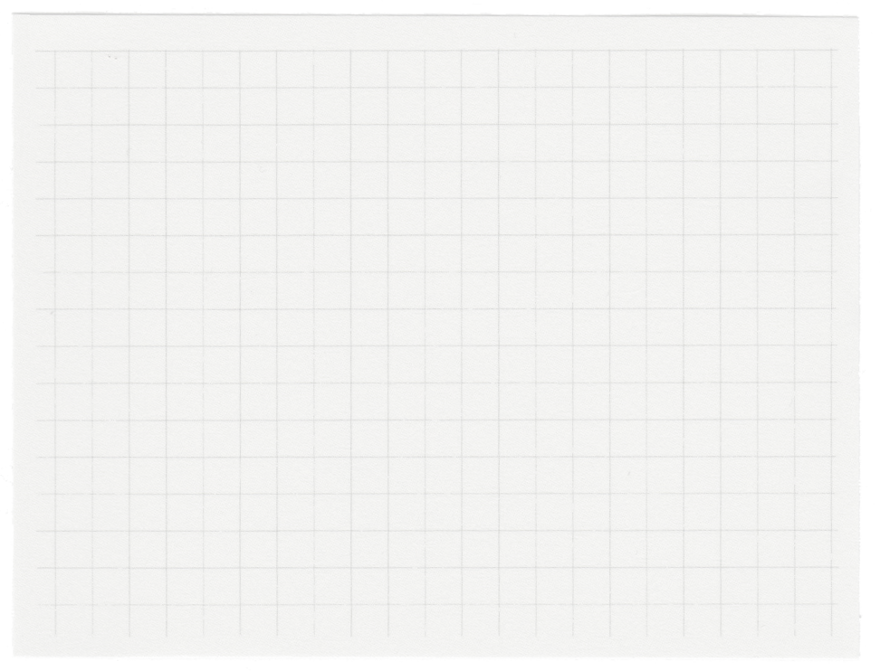













Project Presentation
Presented by Nimba Sumeeth Singh

Slide 2



Let’s Get Started
Introduction
Objective & Scope Of the Project
Application Tools
Project Design
Flowchart
Testing And Validation
Challenges Faced
Conclusion
Limitaitons
References

Slide 3
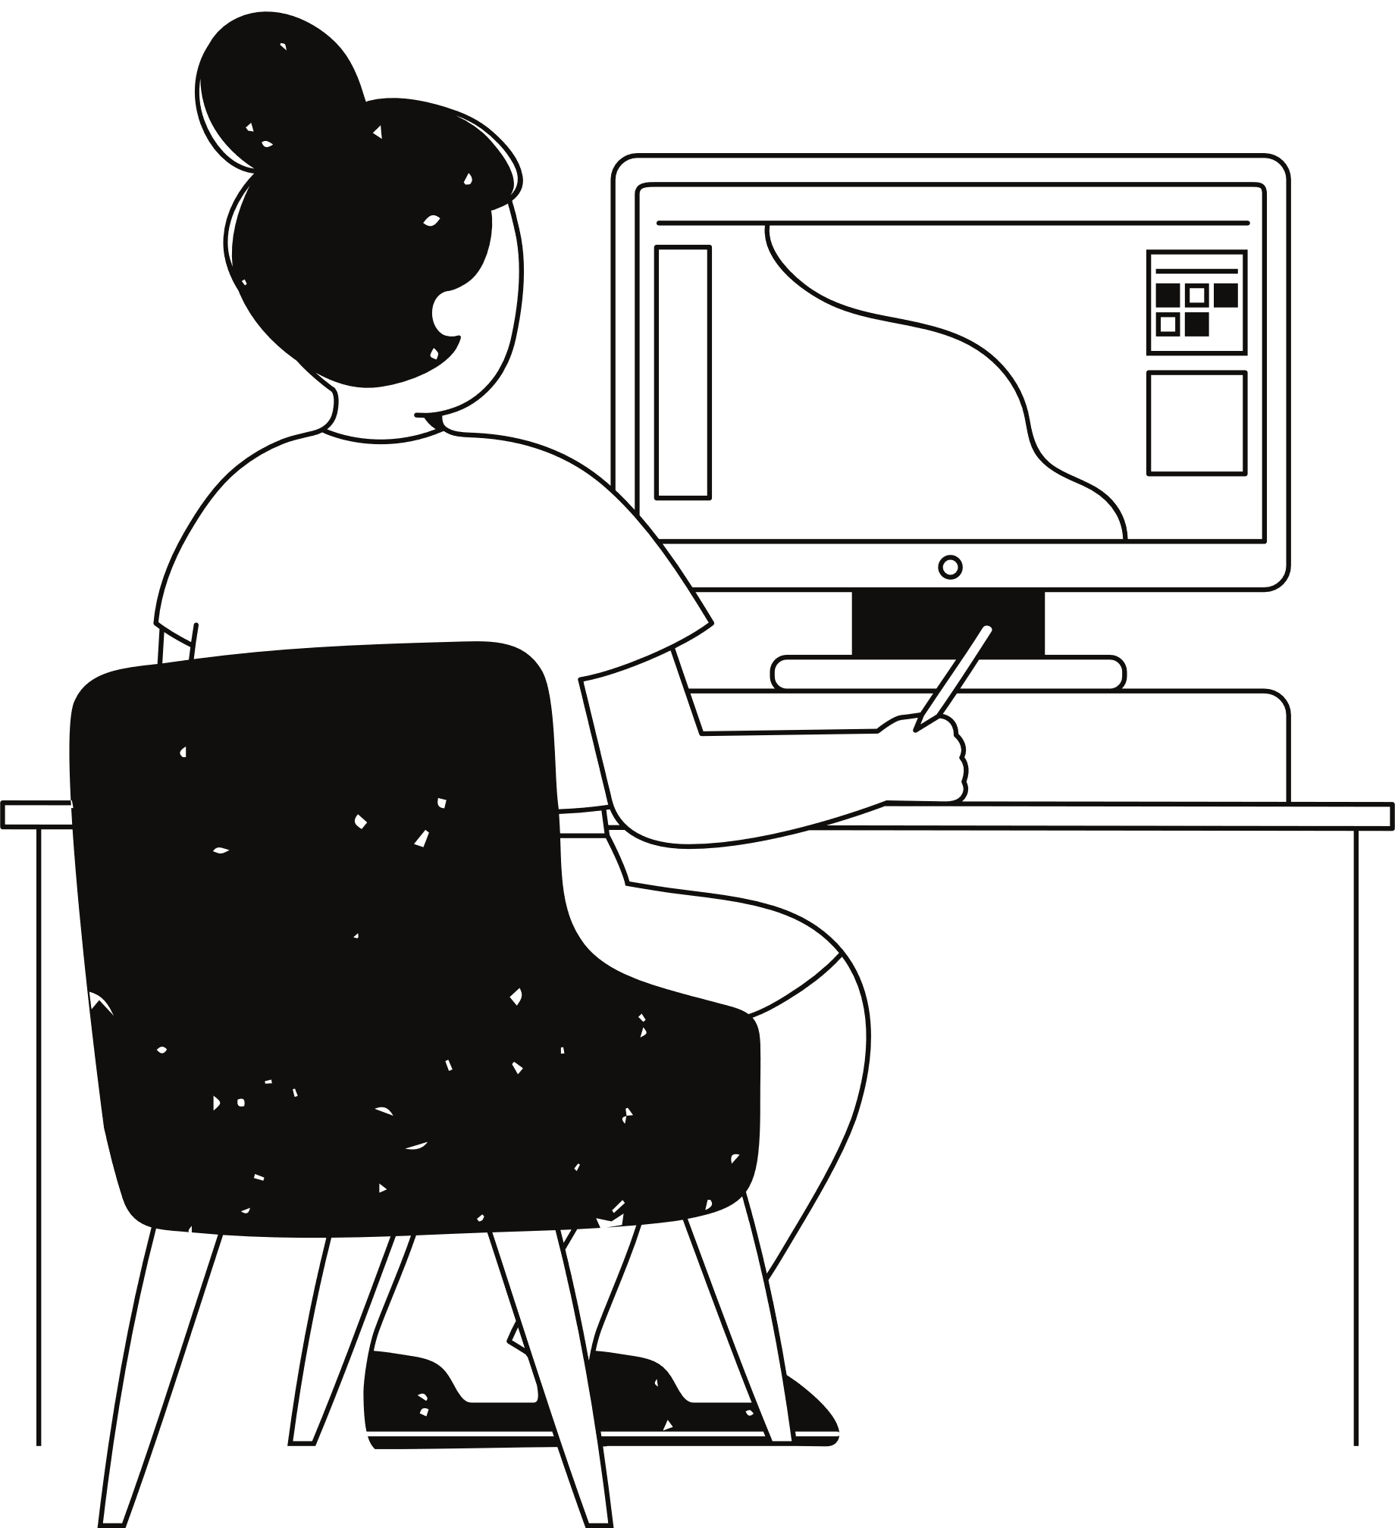
Introduction
The shooter game project is a dynamic 2D action game developed using Python and the Pygame library. This project aims to deliver an engaging gameplay experience, blending fast-paced combat, strategic resource management, and interactive level progression.
The game challenges players to navigate through multiple levels, battling AI-controlled enemies, collecting resources such as ammo, health, and grenades, and overcoming various obstacles. Designed with modular and scalable architecture, the project also serves as an educational tool for learning fundamental game development principles, including sprite-based animation and collision detection.

Slide 4
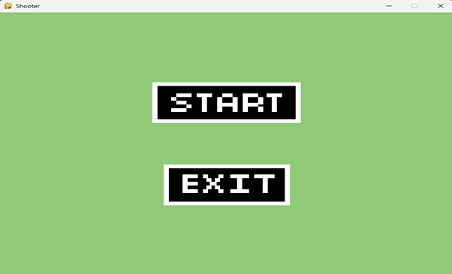
Objective Of the Project
Develop Core Game Mechanics:
Implement essential gameplay mechanics, including player movement, jumping, shooting, and item collection.
Create a Multi-Level Environment:
Design and implement a multi-level environment where players progress through levels, encountering varied challenges, obstacles, and enemies.
Integrate Item Collection and Power-Ups:
Incorporate health, ammo, and grenade pickups that players can collect to enhance their survival and combat abilities.
Provide a Realistic Gaming Experience:
Include visual and sound effects that enhance the realism and immersion of the game, such as background music, shooting sounds, explosions, and health indicators.
Ensure Smooth Player Experience and Controls:
Design intuitive controls for movement, shooting, and item interaction, ensuring responsive gameplay. o Optimize game performance to maintain a stable frame rate and smooth animations throughout gameplay.

Slide 5
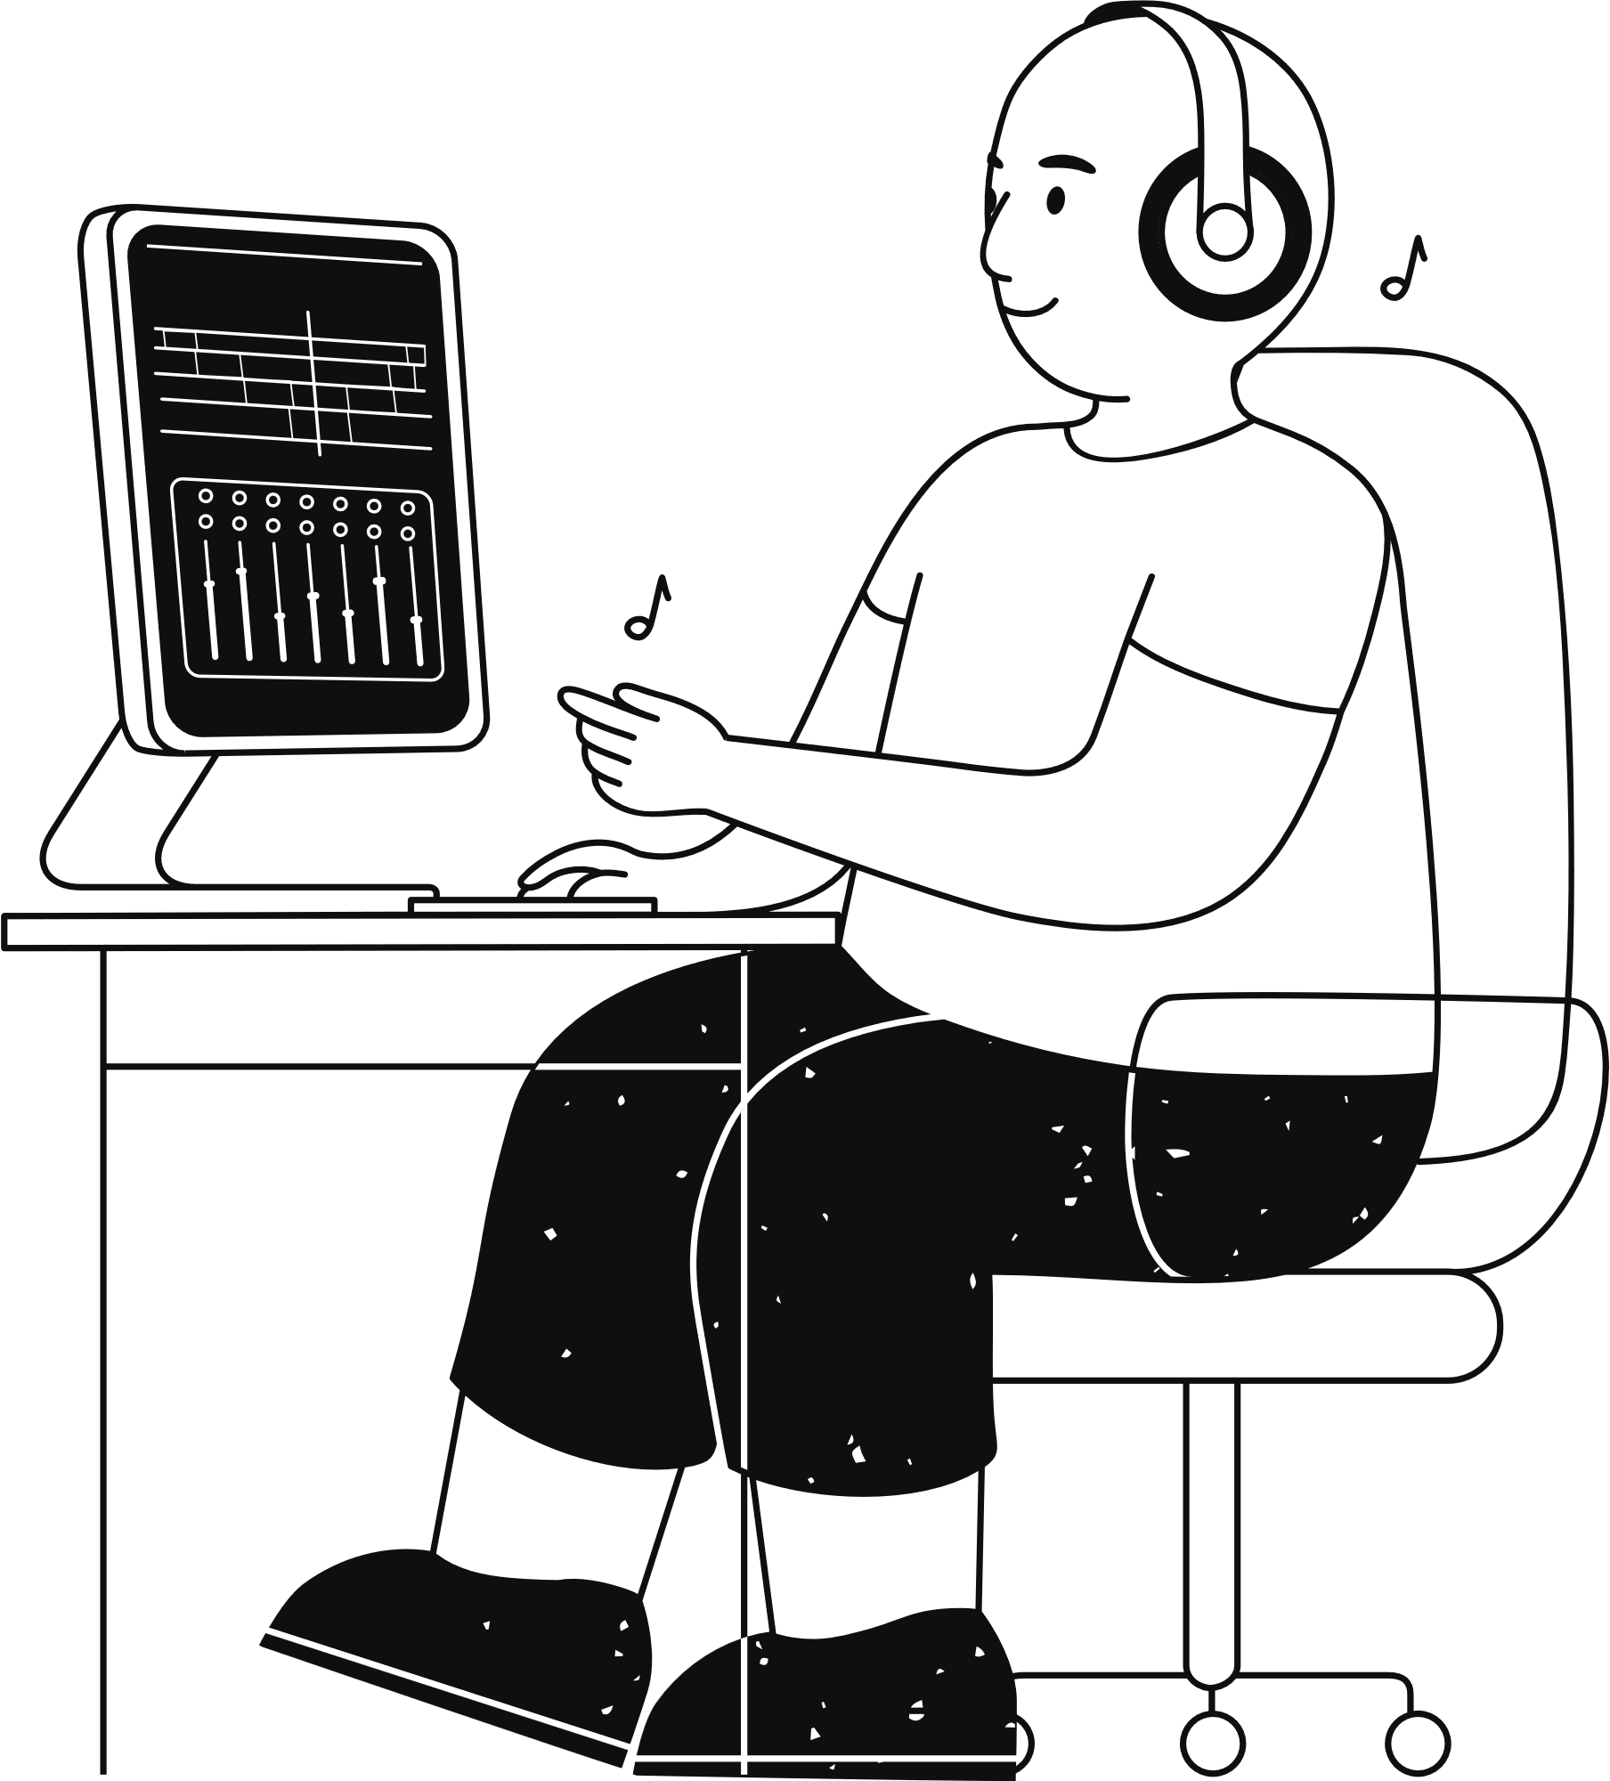
Scope Of the Project
The scope of this project includes the development of a single-player 2D Shooter Game with the following features:
Single-Player Gameplay: The game focuses on a solo player experience where the player navigates through levels, encountering various challenges and enemies.
AI-Driven Enemies: Enemy characters possess basic AI behaviour, enabling them to patrol, detect, and attack the player.
Level Progression System: The game is structured to include multiple levels, each with distinct layouts, obstacles, and enemy placements.
Item and Health Management: Players can collect resources such as health packs, ammo, and grenades, all of which impact gameplay and strategy.
Health and Scoring System: A health bar system provides a visual representation of the player's health, with scoring elements based on performance in each level.
Visual and Sound Effects: Integration of graphics and sound to enhance the immersive experience, with explosions, background music, and custom animations.

Slide 6
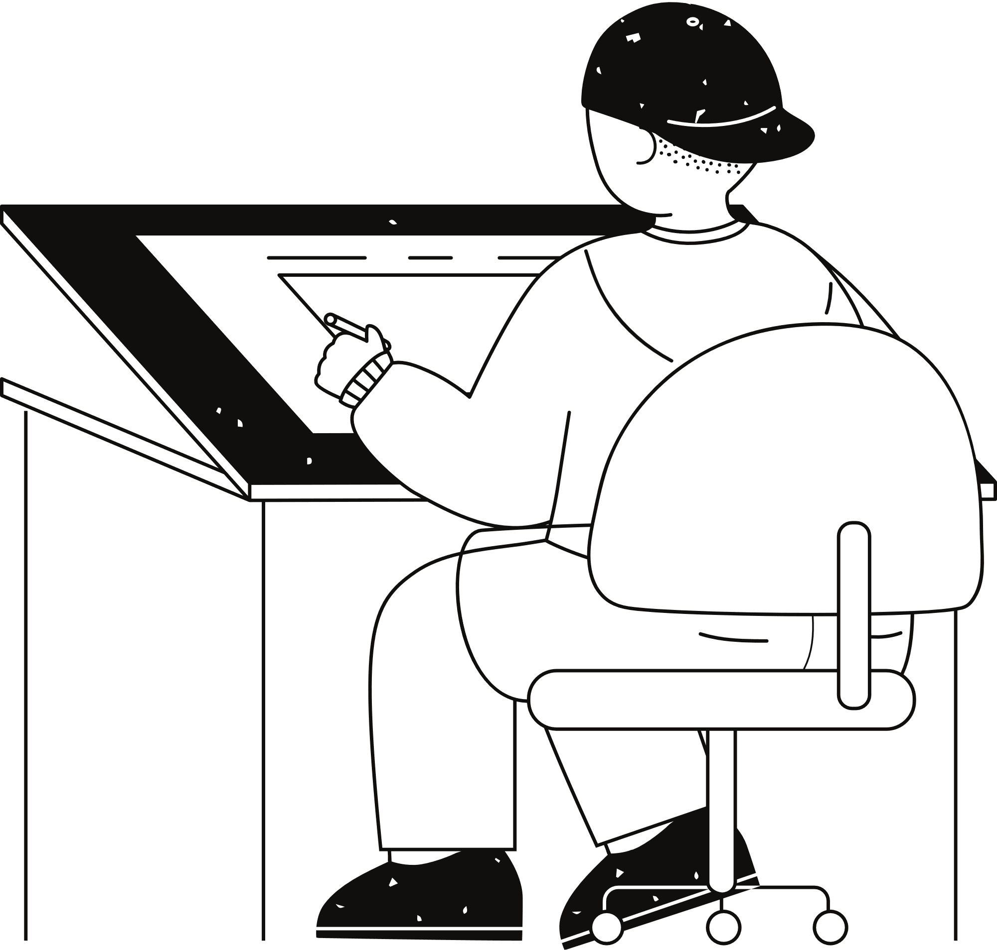





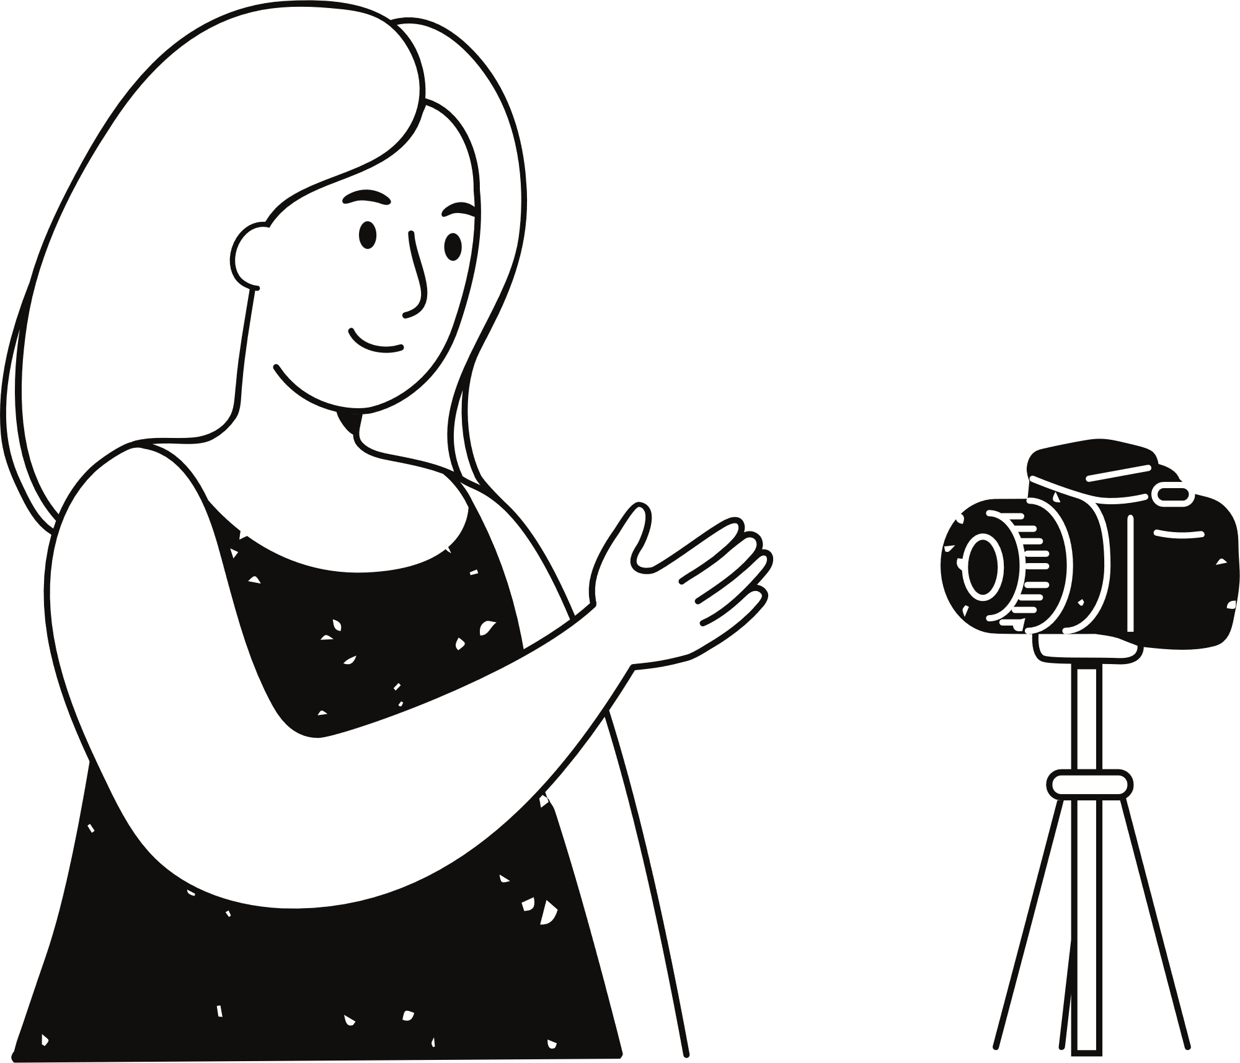
Programming Language
Python:
Used for implementing the game's logic, handling animations, and managing game mechanics.
Sound Editing Software:
Audacity:
For editing sound effects and background music, ensuring proper volume levels and format.
Libraries
Pygame:
Core library for game development, enabling sprite management, event handling, and rendering of graphics and sounds.
Testing Tools
Pygame Debugging Features:
For monitoring game states, detecting errors, and fine-tuning gameplay elements.
Application
Tools
Development Tools
IDEs:
PyCharm: For coding, debugging, and managing project files.
Visual Studio Code: An alternative IDE for quick editing and testing.
Level Design Tools
CSV Editors:
Microsoft Excel or Google Sheets:
For creating and editing level data stored in CSV files.

Slide 7
Project Design
Game Initialization and Setup
Main Game Settings: Sets up screen dimensions, frame rate, game variables, and loads assets like background images, character sprites, and sound effects.
Display and Clock: Initializes the game screen and Pygame’s clock, which ensures a consistent frame rate for smooth animations and gameplay.
Primary Components and Classes
Soldier Class:
Methods:
move(): Handles character movement based on player input or AI logic.
shoot(): Enables the player and enemies to fire bullets, creating bullet objects in the game.
ItemBox Class:
Methods:
update(): Updates position based on screen scroll and handles collision detection with the player.
HealthBar Class:
Methods:
draw(): Renders the health bar based on the player's current health, with a visual indicator for health level.
Bullet and Grenade Classes:
Methods:
update(): Moves bullets and grenades, checks for collisions, and applies damage upon impact.
Explosion Class:
Methods:
update(): Animates explosion frames and checks for nearby characters to apply damage.
Supporting Functions
draw_bg(): Draws a parallax-scrolling background to create depth, adjusting the position based on player movement.
reset_level(): Resets game elements such as enemies, bullets, and items at the start of each level or after player death.
Main Game Loop
Gameplay Logic: Updates all game elements (player, enemies, projectiles, items) based on their respective class methods.
Level Progression: Transitions between levels when the player reaches the exit, loading new level data and resetting positions.

Slide 8
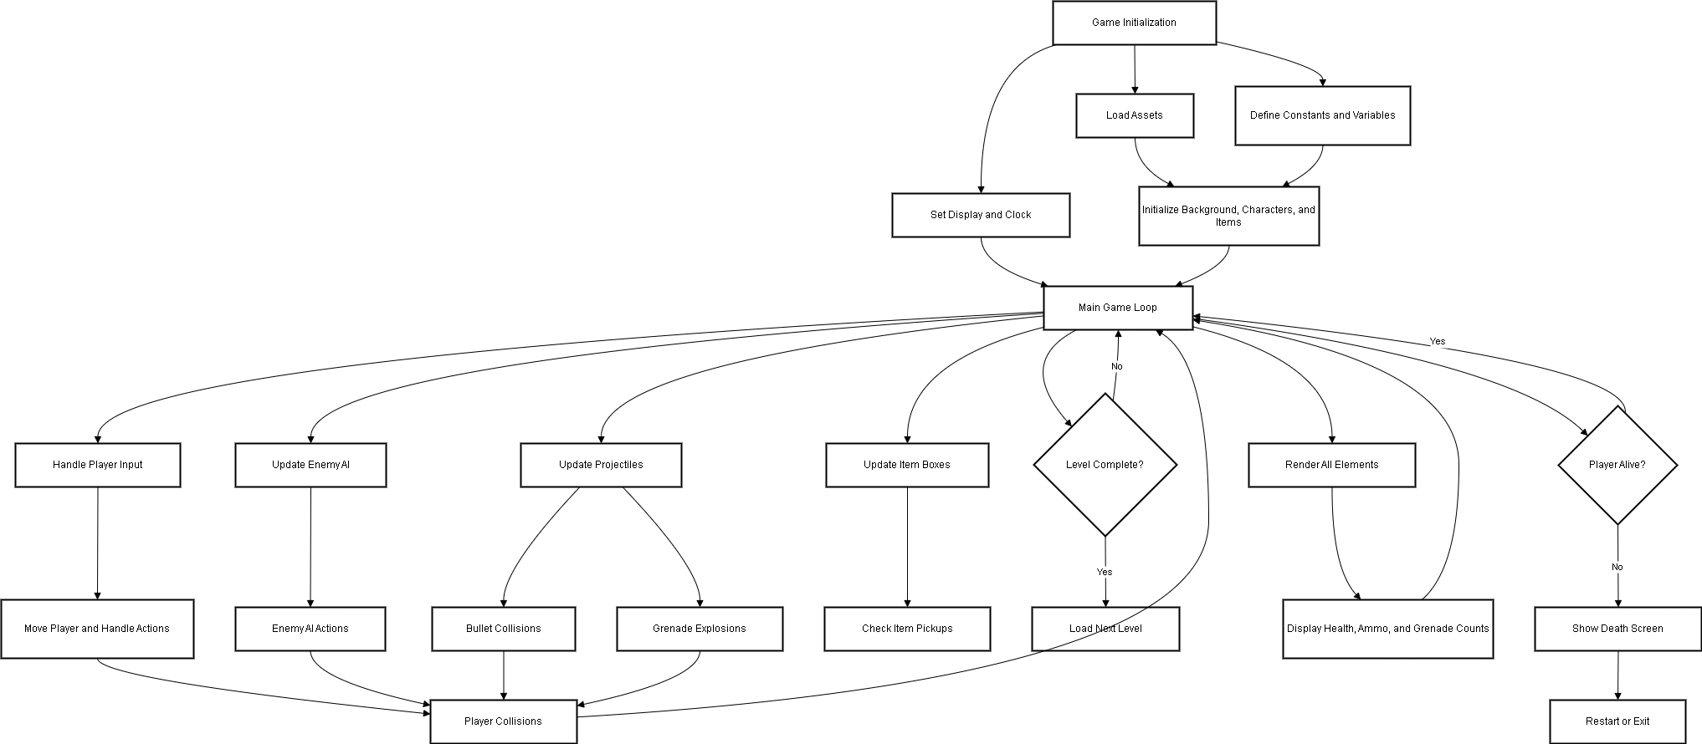
FlowChart

Slide 9
Testing & Validation
Unit testing
Integration Testing
System Testing
Manual Testing
Performace Testing
Verifies the functionality of individual components or methods.
Key Areas Tested:
Player movement (left, right, jump).
Shooting and grenade mechanics.
Collision detection with obstacles and enemies.
Checks how well different components interact with each other.
Key Areas Tested:
Interaction between player and enemies.
Resource management (item pickups, health updates).
Level transitions.
Validates the entire game workflow to ensure it meets requirements.
Key Areas Tested:
Smooth level loading.
UI updates (health bar, ammo count).
AI behavior (patrolling, attacking).
Game was manually played under various scenarios to identify issues.
Key Areas Tested:
Simultaneous actions (move, shoot, jump).
- Performance under high-stress conditions (multiple enemies, explosions).
Ensures the game runs smoothly across different environments.
Key Areas Tested:
Stable frame rate (60 FPS target).
Resource loading times (graphics, sound).
Smooth scrolling and animations.

Slide 10
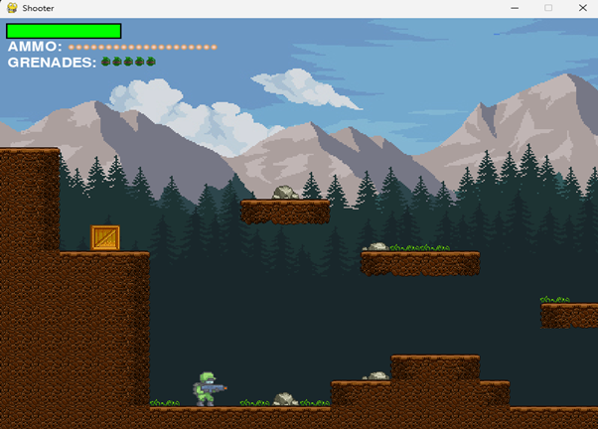
Challenges Faced
Player and Enemy Interaction
Enemy AI Behavior
Challenge:
Ensuring smooth and realistic interactions between the player and enemies, such as detecting collisions and handling health reduction dynamically.
Solution:
Implemented precise collision detection using Pygame’s sprite collision methods (pygame.sprite.spritecollide).
Challenge:
Designing AI for enemies that feels challenging yet predictable enough for fair gameplay.
Preventing enemies from getting stuck at edges or obstacles.
Solution:
Introduced a patrol system with direction-switching logic when obstacles are detected.
Level Design
Collision Detection Performance
Challenge:
Creating multiple levels with increasing difficulty while maintaining variety and interest.
Loading level data dynamically and ensuring seamless transitions.
Solution:
Used CSV files to design and load levels dynamically, making it easier to create new levels.
Challenge:
Frequent collision checks for bullets, grenades, and characters caused frame rate drops during high-action scenes.
Solution:
Optimized collision detection by limiting checks to relevant objects in the player’s vicinity.

Slide 11
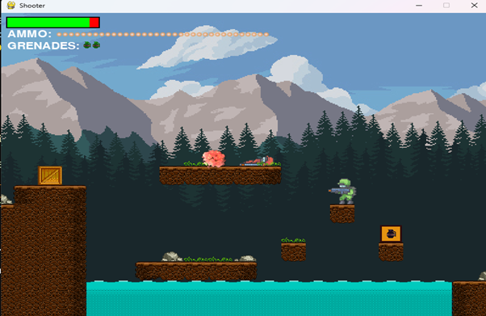
Conclusion
The shooter game project successfully demonstrates the practical application of game development concepts using Python and the Pygame library. It blends dynamic gameplay mechanics, such as player movement, shooting, and grenade-throwing, with interactive elements like enemy AI, resource pickups, and level progression to deliver an engaging and immersive experience.
Key accomplishments of the project include:
A fully functional 2D shooter game with responsive controls and challenging AI.
Modular and scalable code that facilitates easy extension and enhancement.
Visually appealing graphics and synchronized sound effects that enhance player immersion.
Despite these achievements, the project also highlighted areas for improvement:
Enemy AI behavior could be enhanced for greater depth and challenge.
Additional levels, features, and difficulty settings could broaden the game’s appeal.
Optimization for performance under high-action scenarios remains an opportunity for refinement.

Slide 12
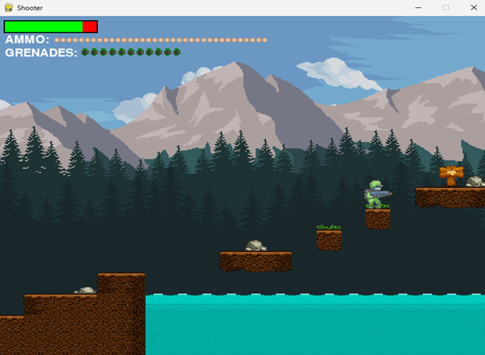
Limitations Of the Project
Limited Levels and Features:
The game includes a small number of levels with straightforward objectives. There are no puzzles, boss fights, or dynamic challenges to diversify gameplay.
No Multiplayer Option:
The game is single-player only, limiting its appeal to users who enjoy cooperative or competitive play.
Static Resource Placement:
Health, ammo, and grenade pickups are placed statically in levels, reducing replayability and surprise elements.
Graphics and Animations:
While functional, the game’s graphics are relatively simple, and animations could be smoother and more detailed.
Audio Complexity:
The sound design, while sufficient, does not include advanced audio features such as adaptive background music or spatial sound effects.
Save/Load System:
The presence of a save/load feature means players can resume from the place where they were playing.

Slide 13
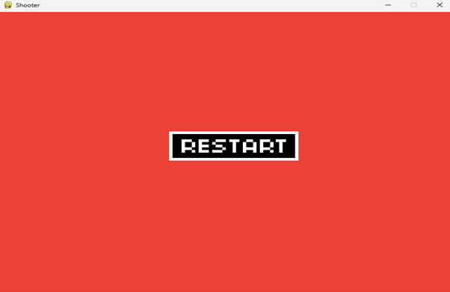
Reference
Pygame Documentation:
Comprehensive reference for Pygame features like sprite handling, collision detection, and sound integration.
https://www.pygame.org/docs/
Python Official Documentation:
Standard library references for os, random, and csv modules.
https://docs.python.org/
OpenGameArt.org:
Source for free and royalty-free 2D game assets.
https://opengameart.org/
Freesound.org:
Repository for free sound effects and audio clips.
https://freesound.org/
Clear Code YouTube Channel:
Tutorials on Pygame game development.
https://www.youtube.com/@CodingWithRuss
Project GitHub Repository:
https://github.com/nimbasumeeth21/Shooter-Game

Slide 14
Thank you very much!

